Slide 1

UNIVERSITY OF COMPUTER STUDIES PATHEIN (UCSP)
Presented Report On
Password
Group ()
March 2020
Guided by Daw.

Slide 2
Members
5CS- Mg (leader)
5CS- Ma
5CS- Ma
5CS- Ma
5CS- Ma
5CS- Mg
5CS- Ma
5CS- Ma

Slide 3
Introduction
.

Slide 4
Objective

Slide 5
Motivation
Internet security
Evaluate password cracker to check security of passwords

Slide 6
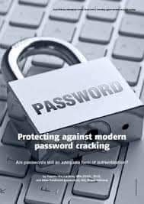
What is Password?
]

Slide 7
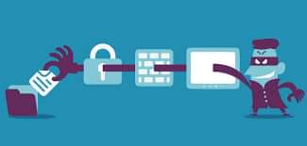
What is password cracking?
The process computer system.
The process passwords.

Slide 8

Benefits of Password Cracking

Slide 9
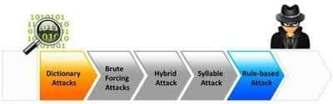
Types

Slide 10
Password

Slide 12
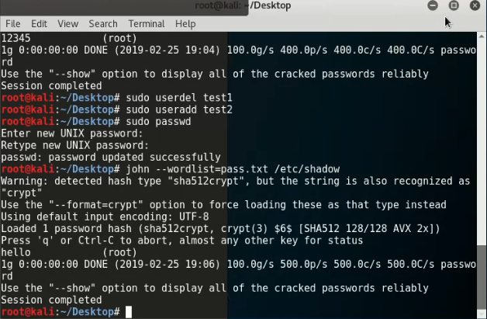
Cracking Linux User Password

Slide 13
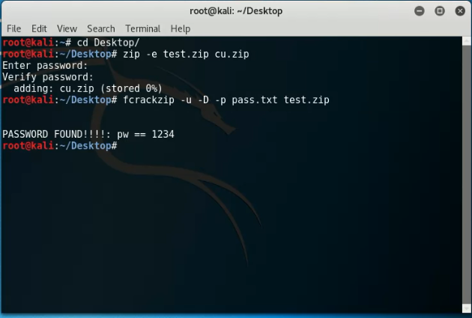
Cracking Password Protected ZIP Files

Slide 14
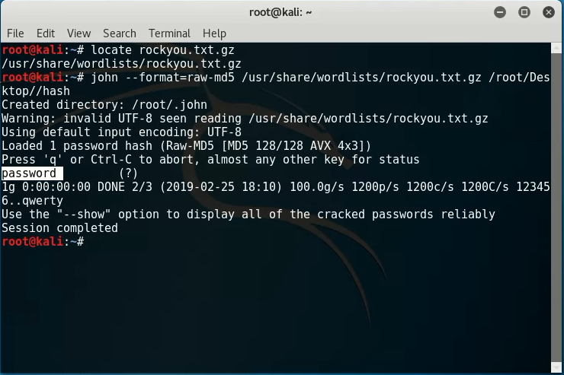
Decrypting MD5 Hash

Slide 15
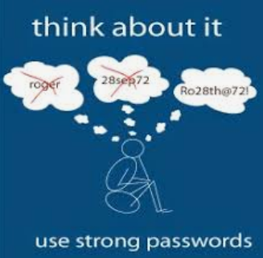
Strong Password
Consists
Letters
Long
Do not user’s own name.

Slide 16
Conclusion
Many.
The.
Hardware.
As.

